Slide 1

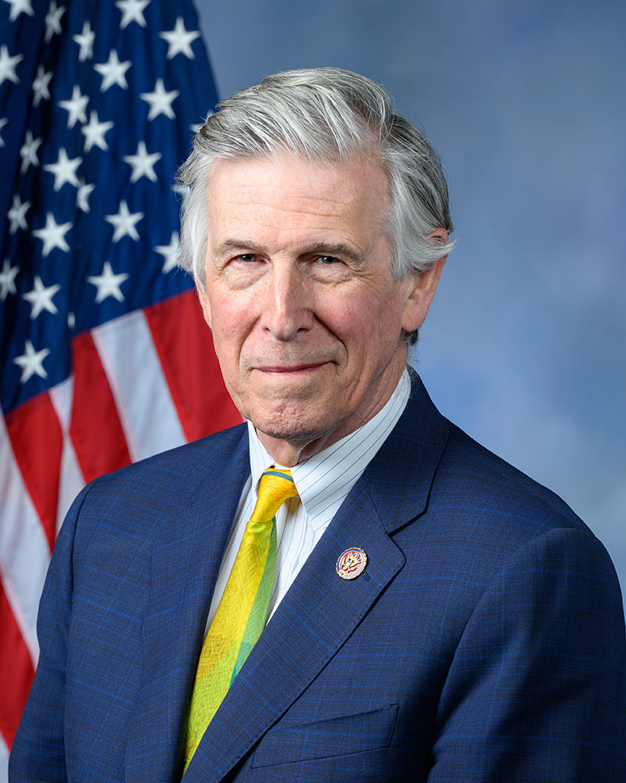
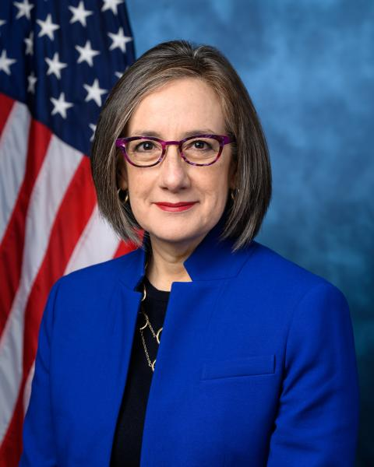
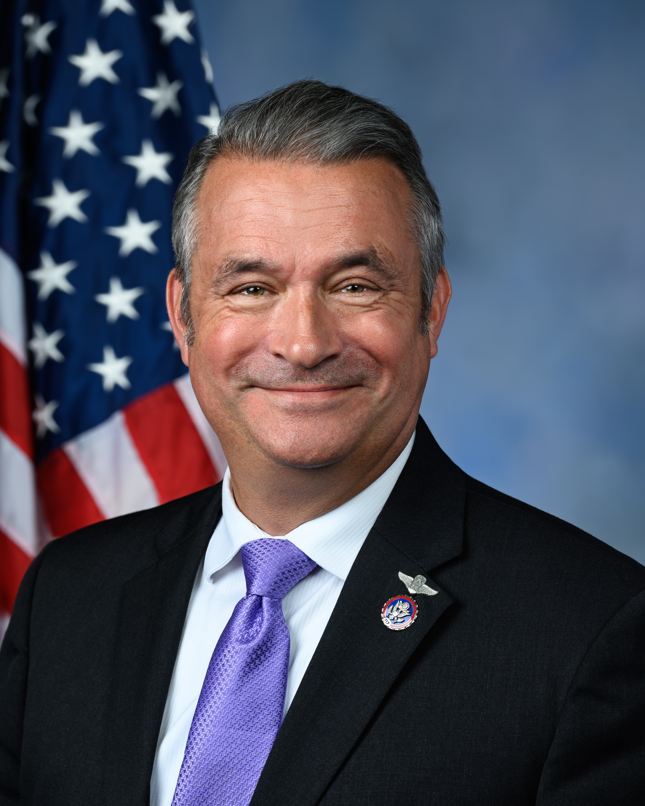
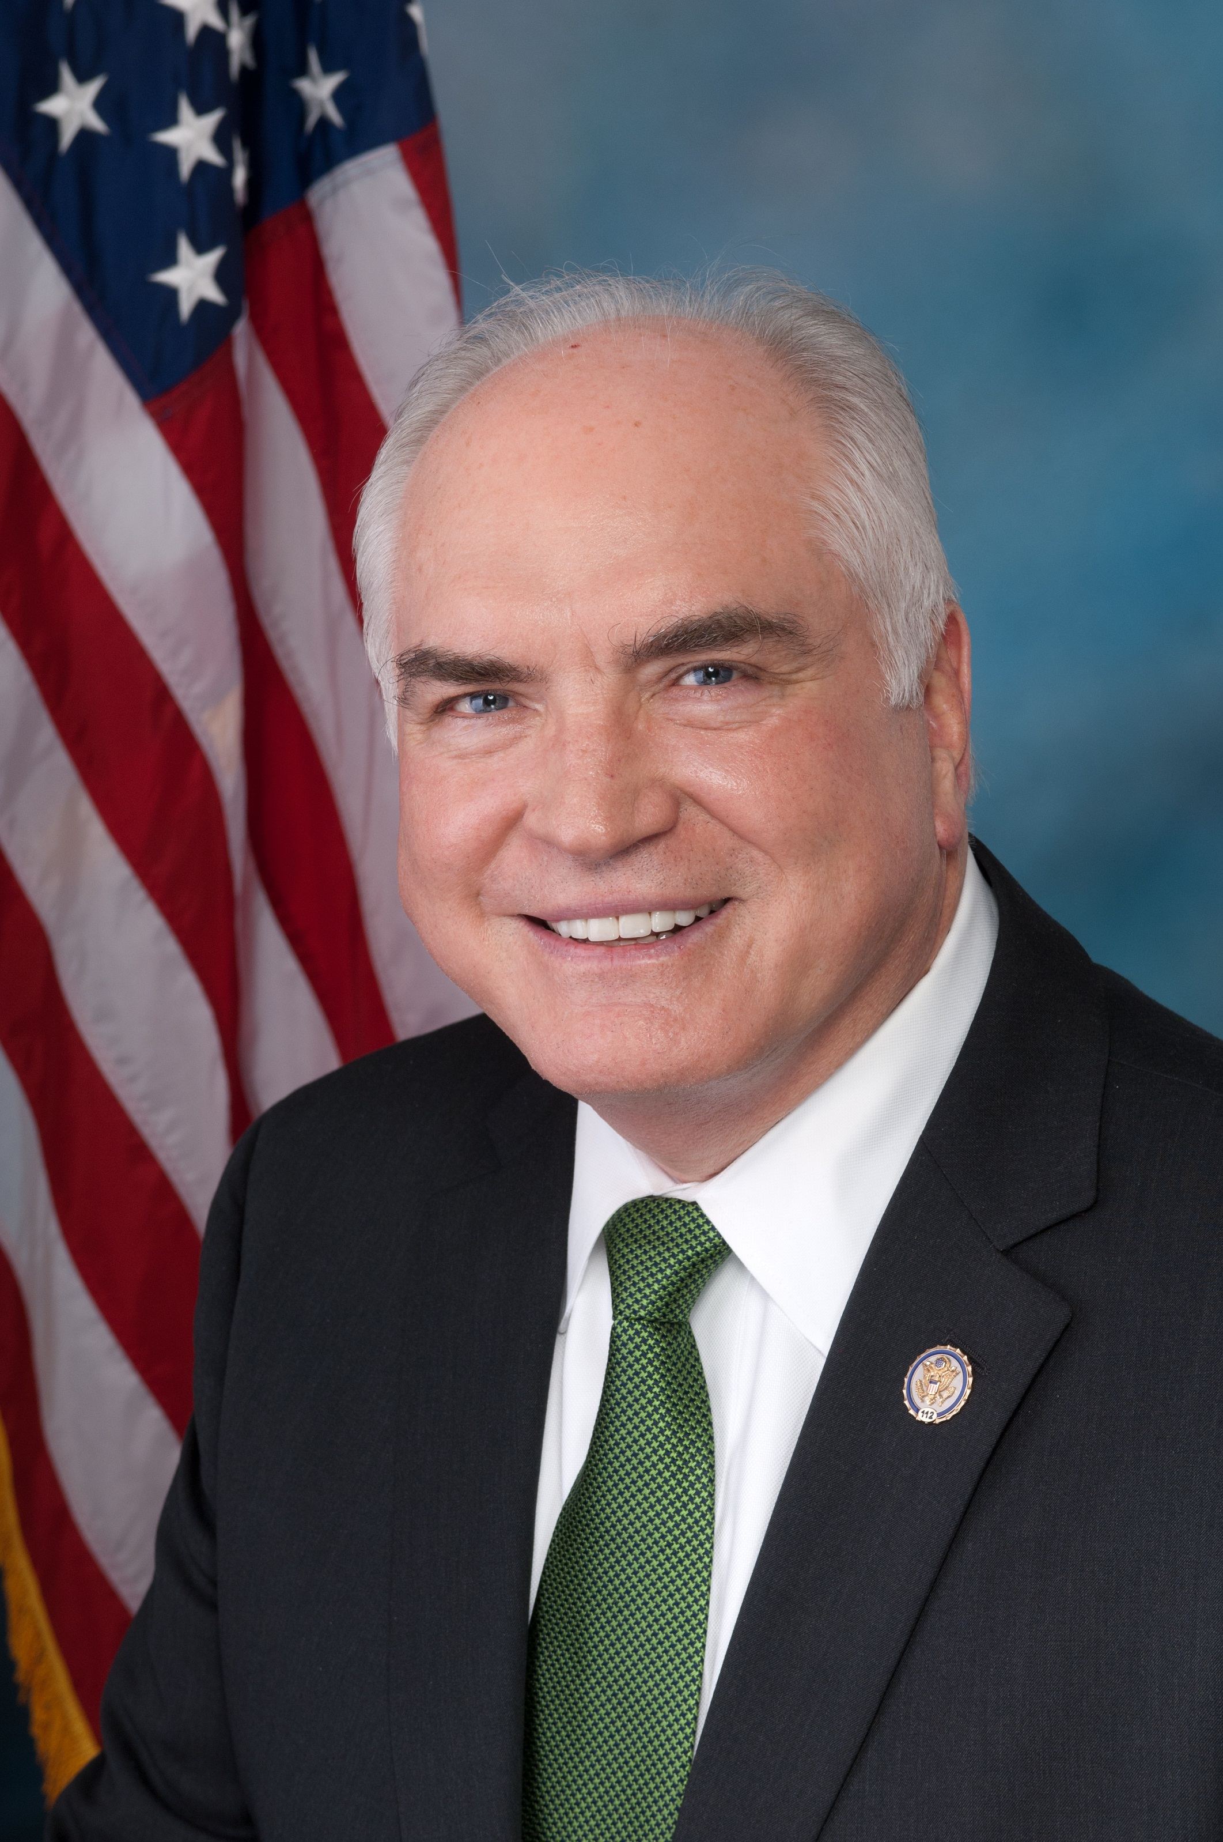
Congressional Reception Honoring the Legacy, Leadership, & Future of the Congressional Mental Health Caucus
Rep. Don Beyer
Co-Chair Mental Health Caucus
Rep. Andrea Salinas
Co-Chair Mental Health Caucus
Rep. Don Bacon
Outgoing Co-Chair Mental Health Caucus
Rep. Mike Kelly
Incoming Co-Chair Mental Health Caucus
Hosted by the Mental Health Liaison Group in cooperation with the Congressional Mental Health Caucus

